Slide 1
Beyond App-Chaining: Mobile App Orchestration for Efficient Model Driven Software Generation
Jens Ziegler, Markus Graube, Johannes Pfeffer, Leon Urbas

Slide 2
Introduction
A core concept for agile production networks of the future is the foundation of Virtual Factories
Involving flexible and dynamic collaborations of various real factories for joint production and commercial exploitation

Slide 3
Introduction
If stakeholders know what the collaboration partners
Can do,
Plan to do,
Have done
How they run their processes,
The engineering and production can become faster and more flexible

Slide 4
Introduction
We propose a pragmatic approach for a Virtual Factory that combines
The advantages of model driven software development
The technologies of the Semantic Web

Slide 5
Linked Data
It uses the principles and technologies of the Semantic Web [4] to publish
HTTP
Uniform Resource Identifiers (URI)
Resource Description Framework (RDF)
Notes:
https://wtlab.um.ac.ir/images/e-library/linked_data/Linked%20Data%20-%20The%20Story%20So%20Far.pdf

Slide 6
Linked Data
It uses the principles and technologies of the Semantic Web [4] to publish
HTTP
Uniform Resource Identifiers (URI)
Resource Description Framework (RDF)
Notes:
https://wtlab.um.ac.ir/images/e-library/linked_data/Linked%20Data%20-%20The%20Story%20So%20Far.pdf

Slide 7
Linked Data
The unified access mechanism to this data is provided by SPARQL [12] endpoints.
SPARQL is the predominant query language for RDF.
It allows federated queries across multiple servers in different companies and domains.
Notes:
https://wtlab.um.ac.ir/images/e-library/linked_data/Linked%20Data%20-%20The%20Story%20So%20Far.pdf

Slide 8
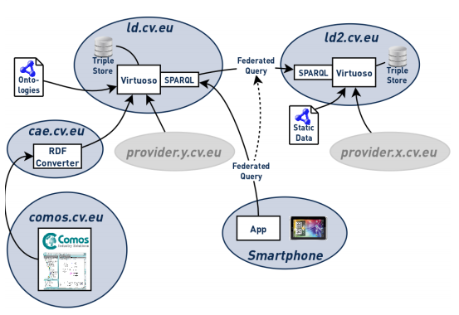
Linked Data
Notes:
computer-aided-engineering (CAE) system COMOS2 running on a third machine

Slide 9
Mobile App Orchestration
Component based software development
Ontology driven software development
Model driven software development
Notes:
https://wtlab.um.ac.ir/images/e-library/linked_data/Linked%20Data%20-%20The%20Story%20So%20Far.pdf

Slide 10
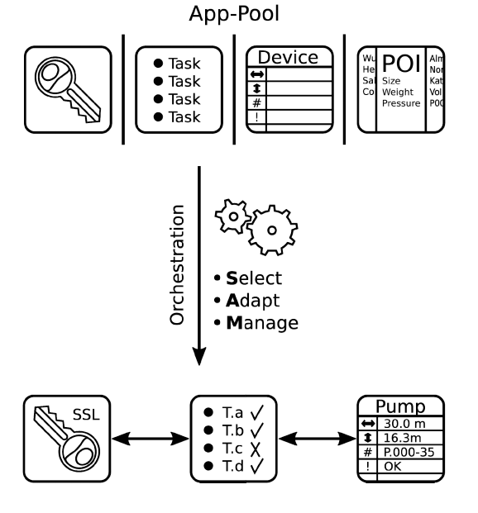
Mobile App Orchestration
Notes:
https://wtlab.um.ac.ir/images/e-library/linked_data/Linked%20Data%20-%20The%20Story%20So%20Far.pdf

Slide 11
Mobile App Orchestration
Select:
Looks at the tasks that are to be supported to identify the invariant of their informational needs and selects the apps that cater best for it
Orchestrator is a human
Automatic selection using the formal description of the apps (e.g. in WSDL)
If the appropriate apps cannot be selected
A placeholder app is selected that must later be replaced with a custom app providing the required functionality
Notes:
https://wtlab.um.ac.ir/images/e-library/linked_data/Linked%20Data%20-%20The%20Story%20So%20Far.pdf

Slide 12
Mobile App Orchestration
Adapt:
Their visual appearance is adjusted
To comply with a corporate design or presentation rules
If the underlying models require specific interaction modalities, such as voice or gesture interaction, these are mapped to the app functionalities.

Slide 13
Mobile App Orchestration
Manage:
The orchestration process enables navigation between apps by placing in-app links
Populating context menus and managing inter-app communications
That is, while a single template app itself is fully independent from others, the apps instantiated by the Orchestration process may have references to other instances.

Slide 14
Proof of Concept
Scenario
The scenario involves an operator of a factory, in this case a chemical plant, and an external service provider who is responsible for the maintenance of the plant
A collaborative information space contains
Engineering data of the plant
Maintenance management data
Current operating parameters of the plant’s process control system

