Slide 1
Context-Aware Recommender Systems
Gediminas Adomavicius, Bamshad Mobasher, Francesco Ricci, and Alex Tuzhilin Association for the Advancement of Artificial Intelligence

Slide 2
GOAL
How context can be defined and used in recommender systems
Create more intelligent and useful recommendations

Slide 3
Context in Recommender Systems
Assuming the existence of certain contextual factors：
time, location, and the purchasing purpose
Assuming that each of these contextual factors can have a structure：
Time factor, for example, can be defined in terms of seconds, minutes, hours, days, months, and years
The classification of context that is based on the following two aspects：
What a recommender system may know about these contextual factors
How contextual factors change over time

Slide 4
What a Recommender System Knows About Contextual Factors
Classify the knowledge of a recommender system about the contextual factors ：
Fully observable
when recommendations are made, everything was known explicitly
Know context factors categories：Time, PurchasingPurpose, and ShoppingCompanion factors
Their structure：weekday, weekend, and holiday
Their values of the contextual factors at the recommendation time：when this purchase is made, with whom, and for whom
Partially observable
Some information about contextual factors is explicitly, but not their structure
Unobservable
no information about contextual factors is explicitly

Slide 5
How Contextual Factors Change over Time
representational view
Notes:
CARS大部分的事前準備都是用representational view
Static : context factor明確且不因時間改變，如shirt
若給的定義域與context不相關，難產生推薦結果；若要推薦餐廳，很難從使用者的服裝來決定=>要選擇對的context factor
因為收集之data通常只有部分，可能拿到是舊的data；若推薦電影，每個使用者在不同的context下，很難會有相同的評分
Dynamic : context factor 隨時間變得與該推薦不再相關
因為dynamic 與 unobservable 都會因為不同的context，產生不同的潛在因素
必須使用者正在進行的事情來決定context

Slide 6
Representing and Modeling Context
Given a user profile and a target item to predict user’s rating for that item => user-item pairs
R : Users × Items －＞ Ratings
Given a user profile, a target item and context factors to estimate user preferences on unseen items.
R : Users × Items × Contexts －＞ Ratings
Explicit contextual information (representational views)：
be obtained from users themselves or from sensors.
Implicit contextual information(interactional views)：
be derived or inferred from other observed data.

Slide 7
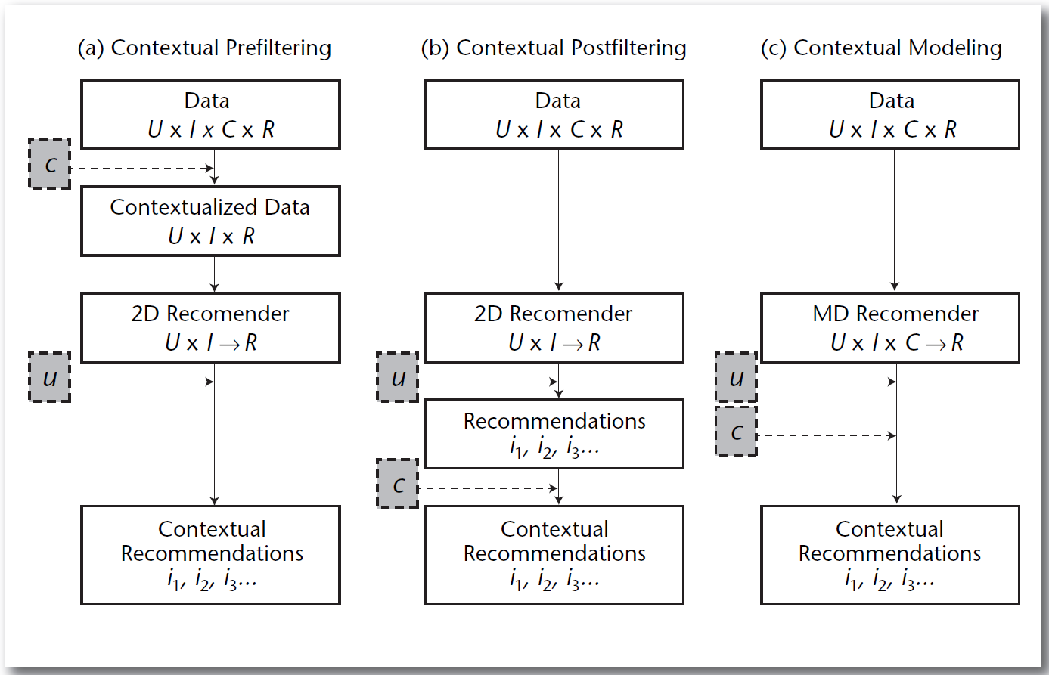
Paradigms for Using Contextual Information

Slide 8
Contextual Prefiltering
Context c essentially serves as a query (or a filter) for selecting relevant rating data.
For example：
If a person wants to see a movie on Saturday, only the Saturday rating data is used to recommend movies.
However, the exact context sometimes can be too narrow.
Generalizes data filtering context ：Saturday ->Weekend
item-splitting ： each item is split into several fictitious items based on the different contexts
micro-profiling： splits the user profile into several subprofiles (possibly overlapping), each representing the given user in a particular context

Slide 9
Contextual Postfiltering
Generating the ranked list of all candidate items from which number of top-N recommendations.
uses contextual information to adjust the obtained recommendation list for each user：
filtering out recommendations that are irrelevant in a given context.
adjusting the ranking of recommendations in the list.
For example：
If a person wants to see a movie on a weekend -> on weekends this user only watches comedies -> filter out all noncomedies from the recommended list.
Heuristic postfiltering approaches：
focus on finding common item characteristics (attributes) for a given user in a given context (for example, preferred actors to watch in a given context)
model-based postfiltering approaches ：
Can build predictive models that calculate the probability with which the user chooses a certain type of item in a given context (for example, likelihood of choosing movies of a certain genre in a given context)

Slide 10
Contextual Modeling
Uses contextual information directly in the recommendation function as an explicit predictor of a user’s rating for an item.
Gives rise to truly multidimensional recommendation functions representing either predictive models：
A tensor factorization method
Single hierarchical regression-based Bayesian preference model that uses Markov Chain Monte Carlo (MCMC) techniques
context-aware support vector machine (SVM) classification method

Slide 11
Key CARS Applications
Physical context:
representing the time, position, and activity of the user, but also the weather, light, and temperature when the recommendation is supposed to be used.
Social context:
representing the presence and role of other people (either using or not using the application) around the user, and whether the user is alone or in a group when using the application.
Interaction media context:
describing the device used to access the system (for example, a mobile phone or a kiosk) as well as the type of media that are browsed and personalized. The latter can be ordinary text, music, images, movies, or queries made to the recommender system.
Modal context:
representing the current state of mind of the user, the user’s goals, mood, experience, and cognitive capabilities.

Slide 12
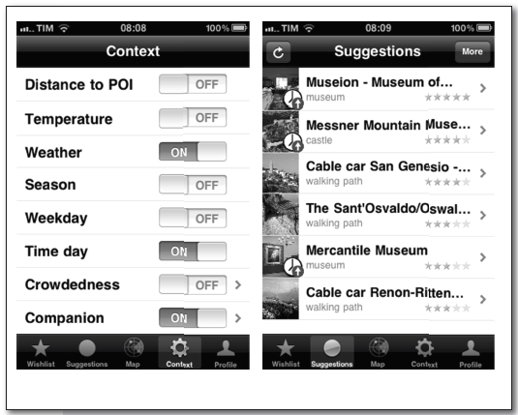
Travel Guides
UbiquiTO, a tourist guide integrating different forms of context-related adaptation:
to the media device type
to the user characteristics and preferences
to the physical context of the interaction
UbiquiTO uses modeling approach (Bayesian Network)
This paper explored a modeling approach (based on factor model)
to assess and estimate contextual information (physical, social, and modal)
for place-of-interest (POI) recommendations relying on subjective users’
evaluations of the impact of contextual conditions ：
the distance of place-of-interest
the temperature (warm)
the weather (sunny)
season (spring)
the time of the day (breakfast)

Slide 13
Proactive and Distributed Approaches
Shopping mall -
The authors classify the possible user behaviors (physical context) in five classes:
standing, viewing, touching, carrying, fitting
RFID sensors and a digital camera are used to detect these behaviors.
The system presents recommendations using three channels:
a display next to the product
a robot interacting with the user
music and sounds illustrating products (modal context)
The proposed recommendation approach is prefiltering by following step：
First checks the position of the user
Then accumulates data on the consumer’s actions and discovers commonalities among the items that were interesting for the user
Finally recommends personalized item information to the user

Slide 14
Conversational/Adaptive Approaches
By observing the human/computer interactions, the recommender is using the interaction state and the data collected to personalize the interaction workflow.
A novel recommendation methodology based on Markov decision processes and reinforcement learning and the adaptation of the interaction media context.
Online travel recommender system -
It is able to assist online users in acquiring their goals more efficiently than the initial strategy.
To a system designer：
to understand the limitations of an existing interaction design
guide the designer how to improve customer relationships, web site usage, and conversion rate.

Slide 15
Music Recommender Systems
Generating a playlist from the user’s music library considering the current user’s physical context.
Temperature, humidity, noise, illuminance, current weather, weather forecast, season, and time of day, a place of interest (POI).
Using a Bayesian network to infer the emotional state of the user (the modal context).
users must explicitly express their preferences for each music attribute in all possible context dimensions.
A system recommending music while the user is reading web documents.
Web page and Music lyrics and its online reviews are represented as text documents
computed the emotion distributions from the term frequencies of two resources

Slide 16
Challenges and Future Research Directions
To deepen our understanding of various ways of incorporating context into recommender systems
Further exploration of the prefiltering, postfiltering, and contextual modeling paradigms
Identifying strengths and weaknesses of each paradigm and determining the utility of different contextual information with respect to different paradigms：
Prefiltering：
context c = (Girlfriend, Theater, Saturday) can be generalized to c1 = (Friend, AnyPlace, Saturday), c2 = (NotAlone, Theater, AnyTime)…
Complex contextual information can be split into several components, and the utility of each piece of contextual information may be different：
Time information (weekday versus weekend) is useful for prefiltering
Weather information (sunny versus rainy) is useful for postfiltering
Notes:
加深我們對各種context組合的了解
找出這三個CARS範式無法解決或部分解釋的學術文章

